Slide 1
MAST Program
Group Project Kick Off – Feb 6th 2017
Notes:
2013-02-08

Slide 2
This presentation
Project Roles
Timetable
Project Outline
Project Inputs
Architecture
Project Activities
Outputs
Other Expectations
Q&A
Notes:
jenny
2013-02-08

Slide 3
Roles & Activities
External Roles
  Architecture Lead (Jenny)
  Product Owner (Joe) joe.j.gaffey@ericsson.com
  Agile Coach (Rachel O’Toole)
Team Roles
  Team Member
  Scrum Master
  Product Owner POC
Notes:
jenny
2013-02-08

Slide 4
Project Timetable
3 week sprints
MON Feb 6th KO
FRI 14th SPRINT 0 DEMOS
MON 20th MARCH Sprint 1 DEMO
MON 10th APRIL Sprint 2 DEMO
Notes:
Jenny
2013-02-08

Slide 5
Important Dates
Project Start
  Feb 3rd
  Information, Sample Dataset, Project Brief
Sprint 0
  Sprint Demo/Review : Monday 23rd February
  3 week Sprint
Sprint 1
  Sprint Demo/Review : Monday 16th March
  3 week Sprint
Sprint 2
  Sprint Demo/Review : Wednesday 15th April
  4 week Sprint
Notes:
jenny
2013-02-08

Slide 6
Project Outline
The Project involves receiving, validating, storing, querying and analyzing sets of network generated Call Failure Data
Specific Project requirements include
  Adherence to an overall Architecture Framework
  Implementation of a set of User Stories addressing
    Import and validation of Call Failure Datasets
    Creation and maintenance of a database of accumulated Call Failure Data
    Data queries and analysis of the accumulated data by different categories of user
Notes:
Jenny + Joe
2013-02-08

Slide 7
Inputs
Core Items
  Project Brief
  User Story List
  Sample Dataset and associated Tables
Additional Support (Template)
  Backlog
  Burndown Chart
Notes:
Jenny ????
2013-02-08

Slide 8
Outputs
Working Software (Demonstrated) !
Supporting Evidence (suggested, not exhaustive…..)
  Design / Architecture Descriptions
  User Story Elaborations
  Prioritized Backlogs
  Sprint Plans & Burndown Charts
  Team Decision Log
Notes:
Rachel
2013-02-08

Slide 9
Groups
GROUP 1 |  |  | GROUP 2 |  |  | GROUP 3
Firdowsa | Ali Hassan |  | David | Leonard |  | Venthan | Chinnakutti
Lily | Beauvilliers |  | Carl | McCann |  | David | Coleman
Michael | Elkins |  | Sahar | Mohamed Ali |  | David | Hedderman
Don | McCarthy |  | Ciaran | Sweeney |  | Bobai | Kato
Paul | McGarrigle |  | Dimitar | Tsvetkov |  | Joel | Mavala
 |  |  |  |  |  | Alexey | Sereda
Notes:
jenny
2013-02-08

Slide 10
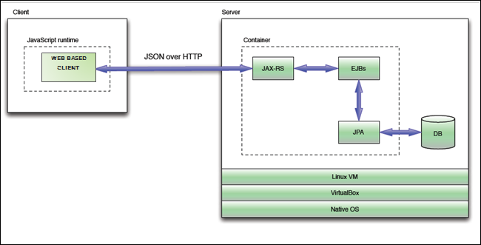
Architecture
Notes:
jenny
2013-02-08

Slide 11
Tools
Github
  EGIT with Eclipse
JIRA
  147.252.89.30:8080
Notes:
jenny
2013-02-08

Slide 12










The Scrum framework
Scrum Team
Iterations
Ceremonies
Scrum
Master
Daily Scrum
24 hours
Daily
Stand-Up
Sprint
Planning
Sprint
1-4 weeks
Team
Sprint backlog
Sprint
Demo
Product
Owner
Release
1-6 months
Sprint
Retrospective
Product backlog
Increment
Notes:
A typical Scrum backlog comprises the following different types of items:
Features
Bugs
Technical work
Knowledge acquisition
By far, the predominant way for a Scrum team to express features on the agile product backlog is in the form of user stories, which are short, simple descriptions of the desired functionality told from perspective of the user. An example would be, "As a shopper, I can review the items in my shopping cart before checking out so that I can see what I've already selected."
2013-02-08

Slide 13
Demo
PART 1 (10 mins )
- description of what you did (slide pack)
- evidence (handouts)
PART 2 (20 mins )
- walk through of the product
Notes:
2013-02-08

Slide 14
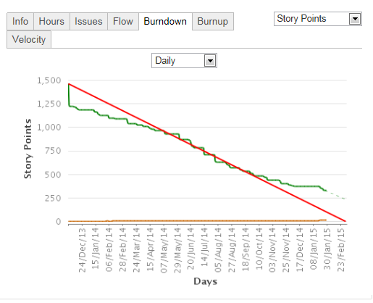
Sample burndown

Slide 15

Advice
Create a Definition of Done within your team; this is your Quality Assurance statement that goes with every User Story
Contact the Product Owner to ensure you understand the user stories to be delivered in the upcoming sprint
Ensure all team members understand what is required in each story
Put acceptance criteria in the user stories
Define a sprint goal so that you can measure your progress in Daily Stand-Up against the goal you have set
During Sprint Planning understand how you are going to develop the user story
Notes:
2013-02-08

Slide 16


Slide 17




Slide 18




PO concerns
    Architecture
        PO can OK Arch decisions from a business value perspective *
        Performance – I have requirements
        Adhere to defined target architecture
    Quality is built in
        Customer satisfaction is key
        Future maintenance (auto test)
        Future development – add ons / re factors
Want full DOD User stories
Not lots of ‘partials’

Slide 19


As a Network Operator
I want to use LTE Network Event data to manage errors occurring in the service I provide
So that I retain customers by ensuring they get a better level of service.

Slide 20
LTE (4G) Network Event data
Records relate to Call Failures in an LTE Network
    Event Time (DD/MM/YYYY HH:MM)
    Event ID (Call Failure Event Type)
    Failure Class (Higher Order Failure Classification)
    User Equipment (Mobile Device) Type
    Market & Operator Codes (Where the failure occurred)
    Cell ID (Cell Identity in the Operator’s Network)
    Duration (Call Failure Duration)
    Cause Code (Failure cause within the Event Type)
    NE Version (Release Level of the Operators’ Equipment)
    IMSI (User Equipment ID)
    Other data…….

Slide 21
Product outline
Use LTE Event data - flat, sequential files
Need to collect and consistency check this data
Organization and storage of this data
Run simple and complex queries, data analysis, correlation and graphing and the modeling of “what if” scenarios.
How I will interact with team
Initial User story spec
Sample data + more later
Demos, comments / tweaks
Queries on the what

Slide 22
Use Cases – Full backlog provided in documentation
3 users
  Customer Support Rep – talking to customer
  Support Engineer – fixing the fault
  Network Management Engineer
    manage results for trend analysis and future planning
  TIP: read the user stories to understand what each user type must/must not have access to.
Typical use cases
  As Customer Service Rep. I want to display, for a given affected IMSI, the Event ID and Cause Code for any / all failures affecting that IMSI
  As a Support Engineer I want to see a list of all IMSIs with call failures during a given time period
  As a Network Management Engineer I want to see the Top 10 Market/Operator/Cell ID combinations that had call failures during a time period
4th User
System admin
High priority too

Slide 23
General expectations
Working in Teams
Everyone participating
Everyone coding
Predictability
Reliability
Improvement
Results (!)
In Sprint 1 & 2 each
person takes a
User Story
to full completion
Notes:
2013-02-08

Slide 24


Thoughts on development
Build towards end use case
    Can break down user stories into smaller ones
    Can demo sql first, api second, gui later…
    Every small use case must lead towards business value
    Don’t implement a java gui and drop it later
Implement 1 Use case first in this way
    And develop similar on same architecture later
Document Architecture plan at start
    And modify it as you go , and decisions to change it

